Slide 1

Introduction a l’entrepreneuriat
INPT NextRest
Aarrasse Ayoub
Kamni Amine
Zaam Oussama
El Haimer Aymane
ASEDS INE1 2021/2022

Slide 2
Section 1: Problem Statement
During meal time, it’s not unusual to stay in queue for long periods of time, which hinders both workers and the students alike.
You can only check your remaining balance on the card after using it and receiving a receipt.
Charging the prepaid card can only be done in certain hours excluding weekends, thus the need to inscribe the students’ names on paper so as to cut the respectable amounts off their cards the next time they recharge them.
ASEDS INE1 2021/2022

Slide 3
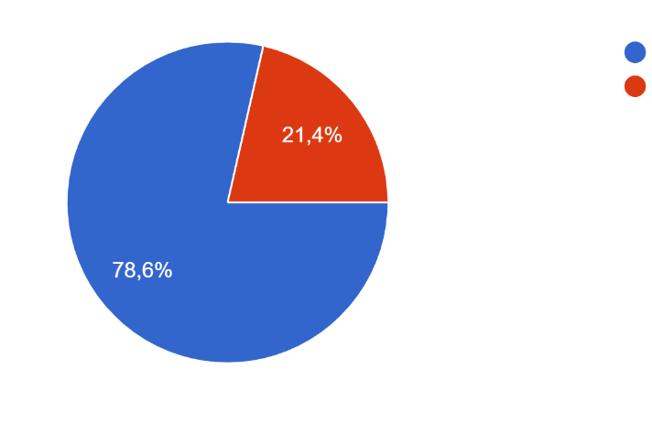
Section 2: Problem Justification
Do you have any issues regarding the restaurant/snack bar?
Yes
No
A pie chart describing the satisfaction/dissatisfaction of the students regarding the current restaurant situation (28 replies)
ASEDS INE1 2021/2022

Slide 4
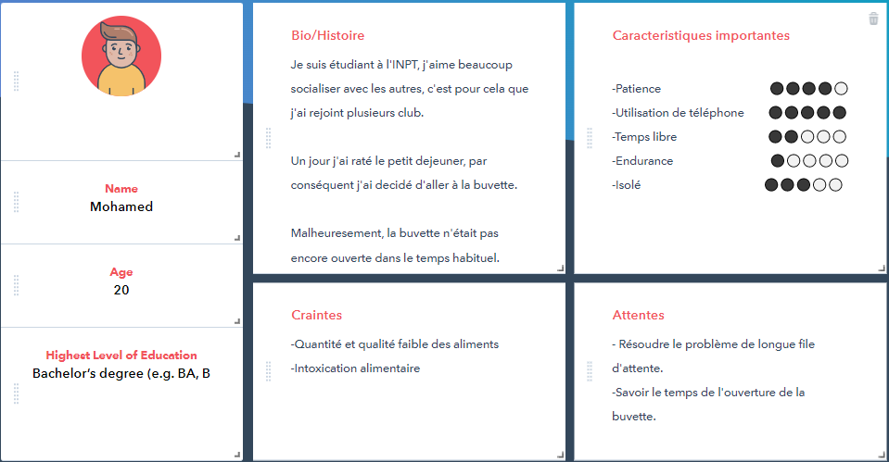
Section 2: Persona
ASEDS INE1 2021/2022

Slide 5
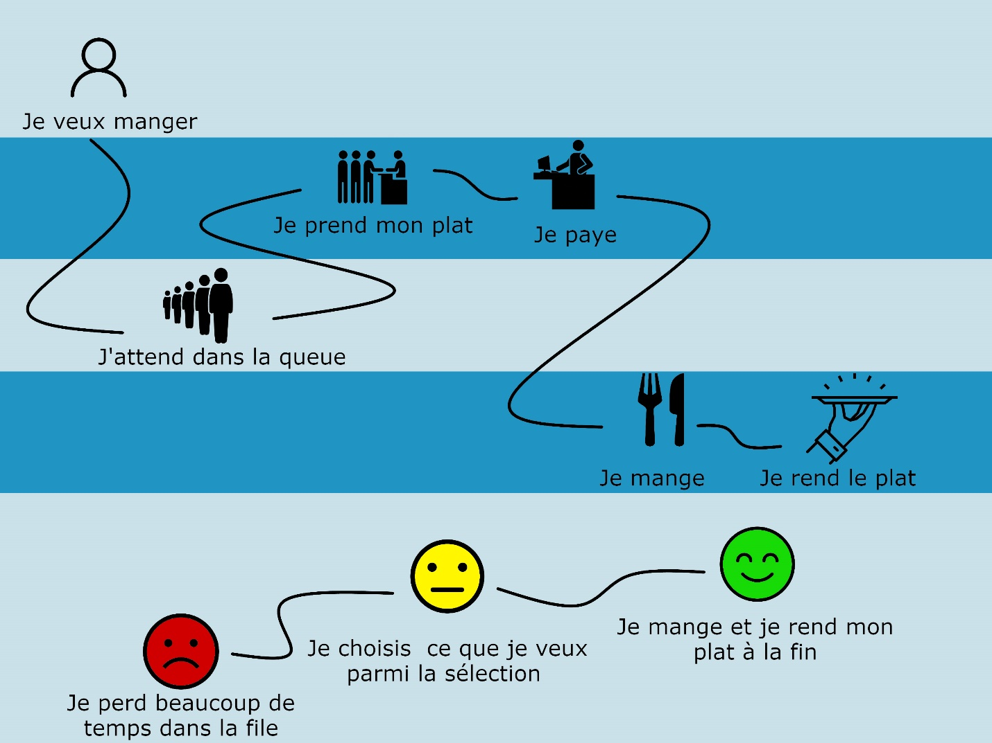
Section 2: User Journey
ASEDS INE1 2021/2022

Slide 6
Section 3: Value
To answer to these various needs, we created a mobile application that will :
Help keep an eye on the queue, and notifies the students about the queue’s status using cameras that are backed by AI technology that would determine roughly how many student are in there.
Provide to the student the ability to charge their restaurant’s card directly through their mobile phones.
ASEDS INE1 2021/2022

Slide 7
Section 4: Business Model
ASEDS INE1 2021/2022

Slide 8
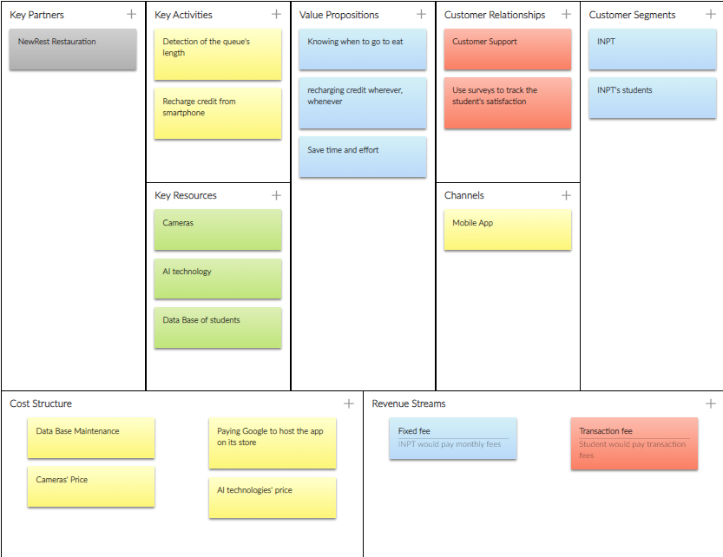
Section 4: Business Model
ASEDS INE1 2021/2022

Slide 9
Section 4: Business Model
Key Partners:
In order for our project that aims to improve the students' experience in the canteen to succeed,
we are in need of the cooperation of the already established NewRest organization
which is in charge of the aforementioned canteen, making it a key partner in our project.
ASEDS INE1 2021/2022

Slide 10
Section 4: Business Model
Key Activities:
Our application will be of service to students, firstly, it will check the
queue and notify the students about it's length, secondly,
it will allow the to recharge their credits through their smartphones,
making them the two key activities that our app promises to deliver.
ASEDS INE1 2021/2022

Slide 11
Section 4: Business Model
Key Resources:
The app makes use of Cameras AI technology and needs access to a
database of students in order for it to achieve results making these the
three key resources our app needs.
ASEDS INE1 2021/2022

Slide 12
Section 4: Business Model
Value Proposition:
in addition to that, our application promises to allow students
the freedom of recharging their credits anytime anywhere,
and to save them time and effort
making them the added value propositions of our app.
ASEDS INE1 2021/2022

Slide 13
Section 4: Business Model
Costumer Relationships:
Furthermore, our application gives access to a costumer
support service, and makes use of surveys in order for it to
guarantee students’
Satisfaction by taking their suggestions and observations.
ASEDS INE1 2021/2022

Slide 14
Section 4: Business Model
Costumer Segments & Channels:
Both INPT and INPT's students will benefit from the project,
making them the customer segments we are targeting, plus,
the project's product
will roll out as a mobile application.
ASEDS INE1 2021/2022

Slide 15
Section 4: Business Model
Cost Structure
The correct operation of the app requires multiple procedures
and needs financial support for the following:
a database maintenance, cameras, Hosting fees and the AI
implementation costs, making these the Cost structures for
our Project.
ASEDS INE1 2021/2022

Slide 16
Section 4: Business Model
Revenue Streams
For the revenue streams, we expect INPT to pay monthly fees
around 3000 DH,
and we are aiming to profit from transaction fees of 5 DH per
recharge made by the students.
ASEDS INE1 2021/2022

